Slide 1
Operating Systems
CSCI-232
Spring 2018
1/13/17

Slide 2
CSCI-232
2
Instructors
Mona Rizvi
TA: Georgiy Krylov
Schedule
Lecture each Friday
Lab each Monday and Wednesday
Required course for all CS majors
1/13/17

Slide 3
Course Model
3
Format
Joint lecture once a week
Labs twice a week
Focus
Systems programming
1/13/17

Slide 4
Resources/References
4
Operating Systems Concepts
by Silberschatz, Galvin and Gagne
Modern Operating Systems
by Tanenbaum
Advanced Programming in the UNIX Environment
by Stevens
1/13/17

Slide 5
Lab Structure
5
Active lab attendance is required
10% of course grade
Lab work itself will usually not be graded
You will be graded by your attendance and work in class, as judged by the instructor and TA in the lab
Lab work should always be completed
You are responsible for the content of labs on tests
Often related to or included in homeworks
1/13/17

Slide 6
Coursework
6
Many of the concepts can be difficult
Best understood through the practical examples
Many of the programming assignments will be demanding
Lots of frustration, testing, debugging
Cannot do them the night before they are due
1/13/17

Slide 7
Work independently
7
Collaborate with your peers in labs …
But do the homeworks yourself
If you use an online resource for some section of code in a homework
Comment the code to say what part(s) came from where
Put a note in your homework report/README
Tests will heavily focus on knowledge you gained by doing the lab exercises and homework
1/13/17

Slide 8
Prepare
8
Load a UNIX-flavor OS on your own computer (if you don’t run one already)
Dual boot
Virtual machine
Boot from USB
Get used to using a shell
Learn to understand man pages
Learn to use a terminal-based text editor
vi/vim
nano
1/13/17

Slide 9
Operating System
9
The software that controls the hardware and resources of a computer system:
Controls access to CPU(s), allowing multiple programs to run at the same time
Manages access to the memory and other hardware/devices
Provides a consistent interface to OS functionality
System calls – functions that directly invoke the operating system, e.g. read(), malloc()
1/13/17

Slide 10
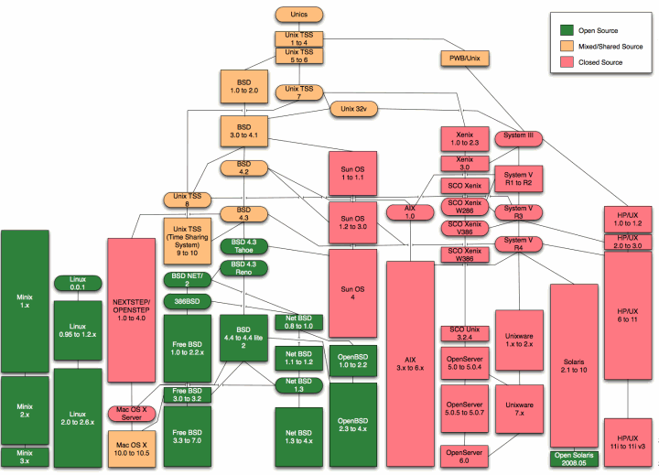
Unix
Family
Tree
(Wikipedia)
10
1/13/17

Slide 11
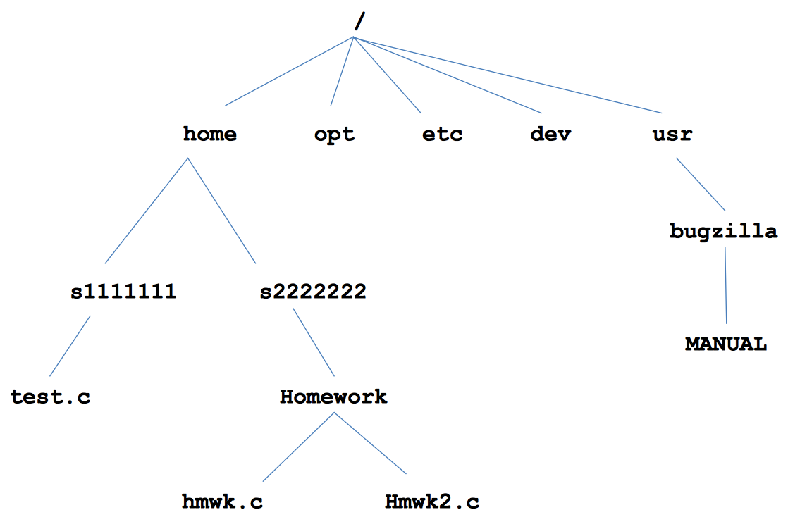
UNIX File System
11
1/13/17

Slide 12
UNIX File System
12
Absolute path
The path to a file starting from root (/)
Example: /home/maerizvi/OS/file.c
Relative path
The path to a file starting from the current working directory
Example: OS/file.c
. (the current directory)
Example: ./a.out
.. (the parent directory)
Example: ../user2/homework.c
~ (the user’s home directory)
File names are case sensitive
1/13/17

Slide 13
Shells
13
A shell is a special program that runs in the terminal
Executes programs
Commands such as ls, cd, pwd are simply programs
Shells include sh, csh, bash, ksh, etc.
Programming language constructs
E.g., loops, if/else, variables (syntax varies by shell)
1/13/17

Slide 14
Shells
14
Shell script
A shell program in a file
A script can be executed directly (with the right permissions)
A script can also be run by passing it as an argument to the shell program
1/13/17

Slide 15
Shell special characters
15
< redirect input (stdin)
myprog < file1
Calls to scanf, fgets, etc. in myprog will read from file1
> redirect output (stdout)
echo “Hello world” > file2
Hello, world will become the contents of file2
file2 will be created or overwritten
Calls to printf, puts, etc. in a program will be written to the specified file
1/13/17

Slide 16
Shell special characters
16
>> redirect stdout to the end of a file (append)
| pipe
redirect stdout of a program to stdin of another
cat file3.c | grep “if” | wc -l
1/13/17

Slide 17
UNIX commands
17
Programs, distinct from the OS, commonly included with the OS
Practiced with the common ones in the lab
cd, pwd, ls, rm, cp, mkdir, etc.
1/13/17

Slide 18
UNIX commands
18
On the command-line (i.e., in a shell), run a program/command by typing its filename followed by any command-line arguments
If the program is not found in the PATH, then the path to the executable file must be used
PATH is a special variable that lists all the directories that should be searched for programs
1/13/17

Slide 19
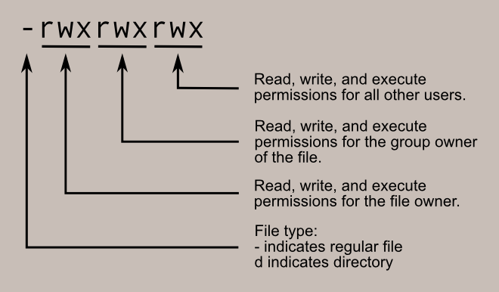
UNIX commands
19
UNIX files have a set of a permissions
Directories, devices, etc. are also files
Files with execute permission can be run
Actual executable nature does not matter
File extension does not matter
Image from linuxcommand.org
1/13/17

Slide 20
UNIX commands
20
Change file permissions with chmod
Interpret each triple (owner, group, all) as 3 bits
Example: chmod 640 file.c
Give the file owner read and write permission 110
Give the group just read permission 100
Give everyone else no permissions 000
chmod +x file.c
This style adds execute permission to every triple
1/13/17

Slide 21
Coming up …
21
Labs: Shell script exercises
Homework: Shell programming
Lecture: C programming review
1/13/17

